Slide 1
Handwriting Recognition
Philip Eisner, Josh Ostrower, Nhan Nguyen, Anders Peterson

Slide 2
Motivation
There are a many project using machine learning to recognize handwriting photos but not many projects that offer real time handwriting recognition.
After surgery patients are often asked to communicate pain on a 1-10 scale. Many times they have trouble communicating with the doctors after surgery and are hard to understand.

Slide 3
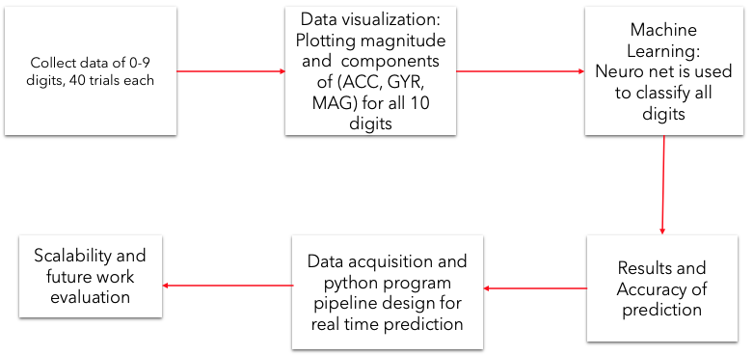
Design Overview

Slide 4
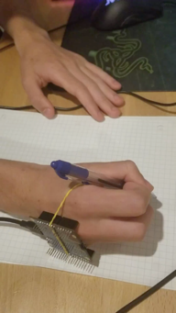
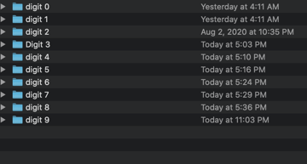
Data Collection
Using the sensor tile, powered by PC via usb-c cable
we collected 40 trials of each digit 0-9.

Slide 5
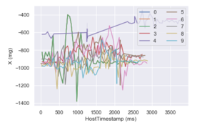
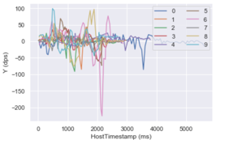
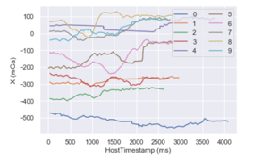
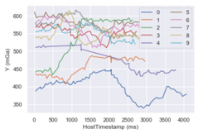
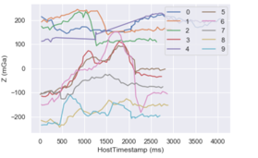
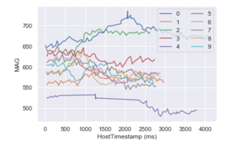
Data Visualization
https://github.com/Phileisner/Handwriting-Recognition/tree/master/Data%20visualization

Slide 6
Importing the data into python
We used a python script to import the data from the .csv files into numpy arrays in order to avoid more manual labor of labelling files and typing in file paths.
It automatically labels the correct digit using the name of the folder the .csv is contained in as well as correctly importing by finding whether the .csv is accelerometer, gyroscope or magnetometer
Show GitHub: https://github.com/Phileisner/Handwriting-Recognition/blob/master/machinelearning/final_workingML.py

Slide 7
Data Processing
After importing the data, we used the mean, min, max and standard deviations of the accelerometer, gyroscope and magnetometer for our model. Before training, we normalized the data by dividing by the mean of the magnitude for each sensor type.

Slide 8
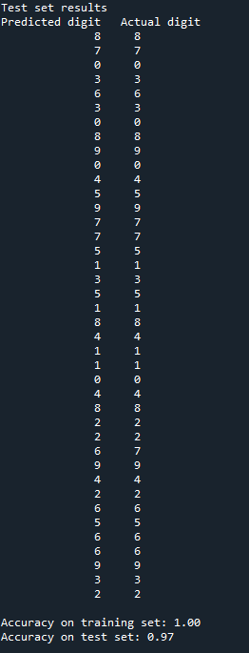
Machine learning
We chose to use a perceptron neural network from sklearn, but experimented with SVM as well. We loaded the data into the neural network and used 90% for training and 10% for testing.
The results varied from 90-100% accuracy on the test data, a very accurate model!
https://github.com/Phileisner/Handwriting-Recognition/blob/master/machinelearning/final_workingML.py

Slide 9
Live Demo
The model can also accept new data for testing after it has already been trained, allowing for future implementation of real-time digit recognition.
https://youtu.be/2XoFCt6Wqj4

Slide 10
Issues and improvements
Due to time constraints and hardware issues, we could not collect much data. Only two members of our group were able to collect data, and any one digit only had one person collecting data.
Because of different writing styles, if the real-time test data is written by someone who did not collect data, the prediction often is not accurate. In the future we would use more data, from more people to encompass more varying writing styles, and at some point it should be applicable to the majority of people.
However, the model is very accurate so long as it is tested using data from the person who trained it, which is very promising for future use.

Slide 11
Future work and Scalability
•Classify all characters in the English alphabet using the same technique.
•Create a gesture detection for spacing between words
•Create a pipeline between the Sensortile data collection system and machine learning model to real-time predict letters and digits
•Fusing the application with a smart text app to create a real-time texting with motion gesture
•Design a truly portable, chargeable wrist-wear Sensortile case

Slide 12
Q & A, Suggestions

